Slide 1
LONGEST COMMON SUBSEQUENCE

Slide 2
Process involved in Longest Common Subsequence
Characterize optimality
Define the recursive solution
Compute the length of the LCS
Construct an optimal LCS

Slide 3
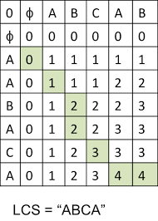
LCS TABLE

Slide 4
Steps involved in LCS table
Match
Mismatch
Traceback

Slide 5
If(input [i]==input[j])
{
T[i][j]=T[i-1][j-1]+1;
else
T[i][j]=max([i-1][j],T[i][j-1])
}

Slide 6
Example
Input:
Two DNA sequence
Seq1:TAGTCACG
Seq2:AGACTGTC
Output:
LCS: AGACG
LENGTH: 5

Slide 7
